Slide 1
【Group 7】
Movie Recommendation System
Notes:
Good Evening We are group 7. We choose movie recommendation system as our topic.

Slide 2

Agenda
1
Introduction
2
Data Processing
3
Recommendation Engine
4
Challenges
5
Evaluation and Demo
Notes:
We will follow this agenda today.

Slide 3
Introduction
Popularity-based engines
Content-based engines
Collaborative filtering engines
The dataset we have describes the content of the films and TV series. So,
We have built an engine that uses both the content and the popularity of the entries to predict.
Notes:
During our proposal presentation we had introduced three types of recommendation systems
popularity-based engines: usually the simplest to implement but is also the most impersonal
content-based engines: the recommendations are based on the description of the movies
collaborative filtering engines: records from various users provide recommendations based on user similarities

Slide 4

Working
The user provides the name of a film he/she liked; The engines applies the appropriate ontologies and selects in the database a list of 5 films that the user will enjoy and recommends it.
Notes:
The recommendation engine works as follows:
The user provides the name of a film he/she liked; The engines applies the appropriate ontologies and selects in the database a list of 5 films that the user will enjoy.

Slide 5
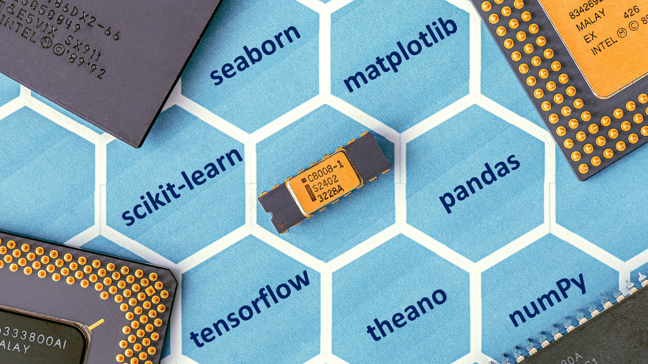
Libraries
Nltk
Matplotlib
Json
Pandas
Numpy
Seaborn
Sklearn
Fuzzywuzzy
Math
Wordcloud
Notes:
Some of the libraries we used are

Slide 6
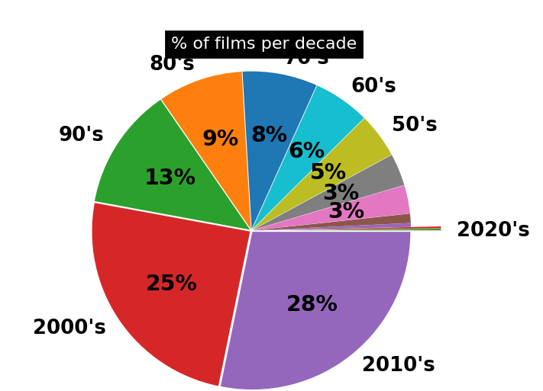
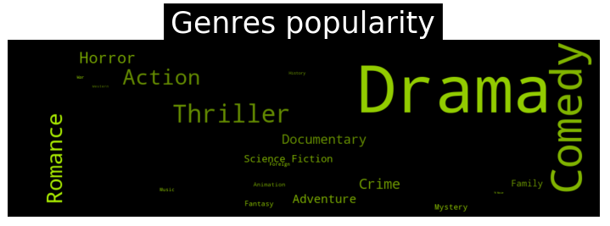
Data Exploration
Size
The data has 27 attributes and 48,000 instances
Missing values
The data has missing values
Number of films per year
The year of each film has been combined into a decade to reduce complexity
Genres
Describes the content of the film
Notes:
We have extensively use keywords that describe the films. Indeed, a basic assumption is that films described by similar keywords should have similar contents.
The genres variable will surely be important while building the recommendation engines since it describes the content of the film

Slide 7





Data
Pre-processing
Duplicated entries
Valid duplicate titles as they are remakes.
Groups of synonyms
Missing title years
< 5 times and replace with synonym of higher frequency
< 3 times suppress
Mean year of activity for the actors and directors - then average the values
Data
Processing
Imputing from regressions
Grouping by roots
Stop words are removed, plot keywords variable – NLTK.
Missing values of the gross, num_voted_users we use their corelation
Keywords
Extracting Keywords
Similar plot keywords means they should have similar contents.
Missing values in the plot_keywords variable using the words of the title

Slide 8
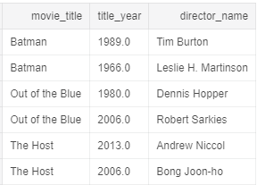
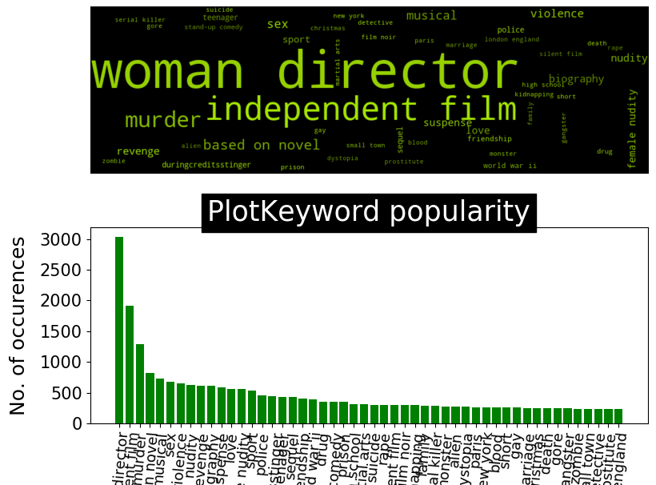
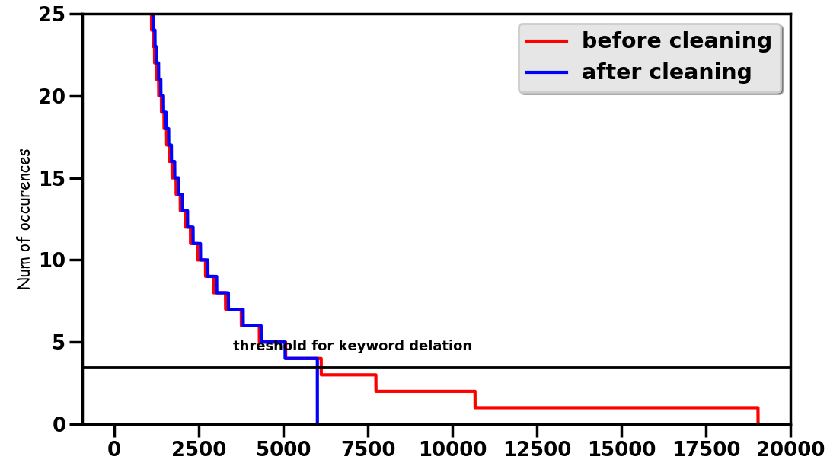

Slide 9
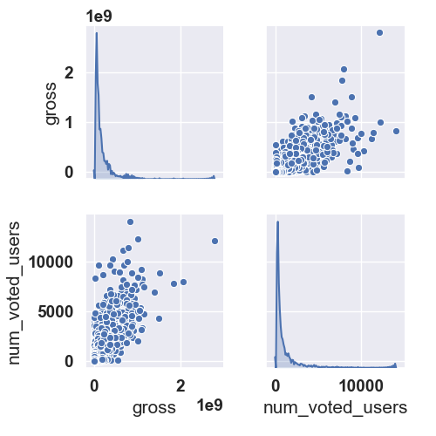
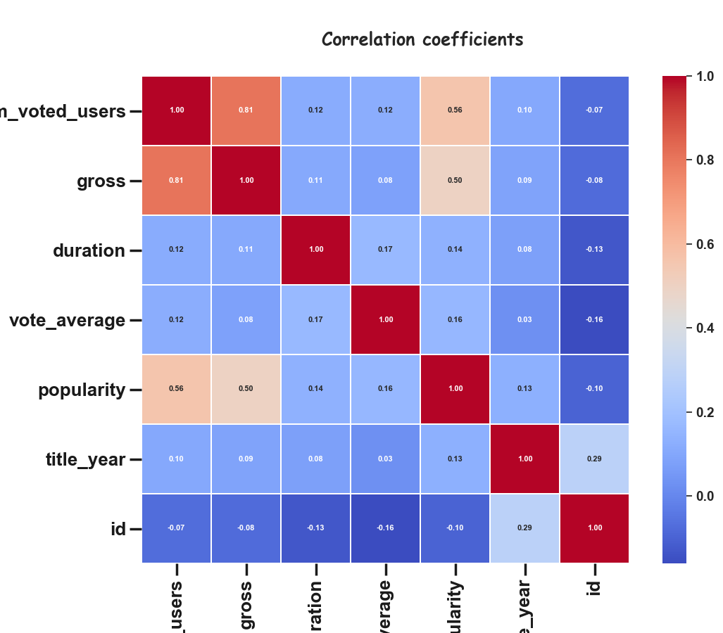
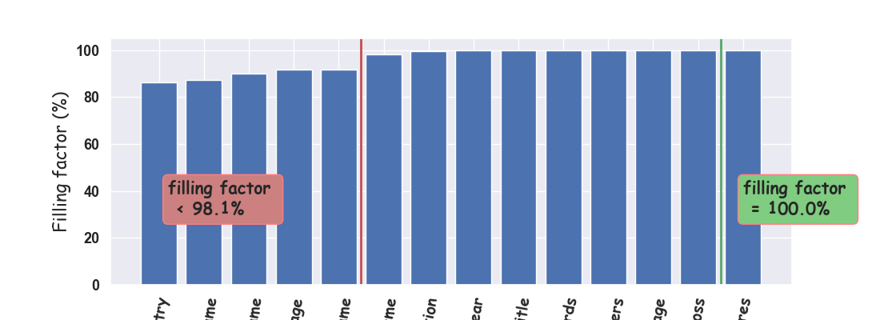

Slide 10
Algorithm
Determine N films with a content like the entry provided by the user
Select the 5 most popular films among these N films.

Slide 11
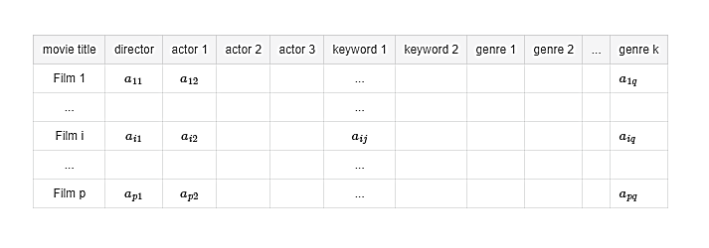
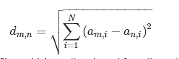
01
Similarity
Step 1: Keywords, Actors, Director etc.. of the given movie and we construct a similarity matrix. aij coefficients take either the value 0 or 1
Step 2: We calculate the distance between the two films. This gives us a list of N films.

Slide 12



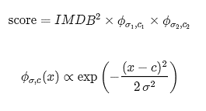
02
Popularity
Step 3: Give a score for every entry. Based on
the IMDB score
the number of votes the entry received
Step 4: we consider year of release as people's favorite films will be most of the time from the same decade. – gaussian distribution.
Notes:
Talk in detail about step 4

Slide 13
Challenges - Solved
Filling in missing year.
Solution: Mean year of activity for the actors and directors - then average the values
Movies in the same decade.
Solution: gaussian distribution.
Making a meaningful recommendation instead of the sequels.
Solution: fuzzywuzzy - remove_sequels()

Slide 14
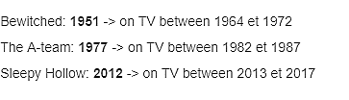
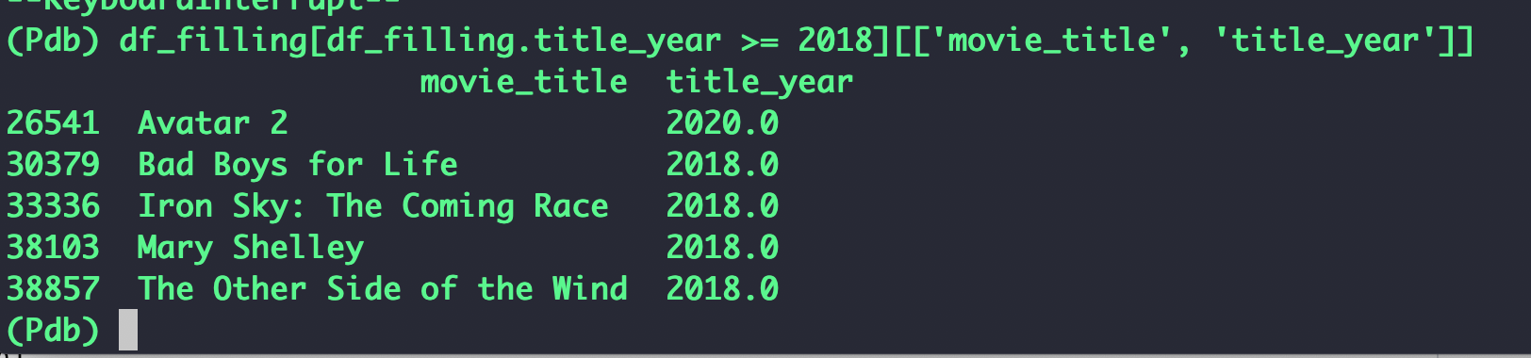

Slide 15
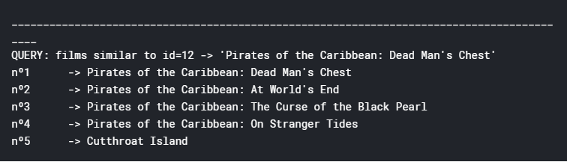
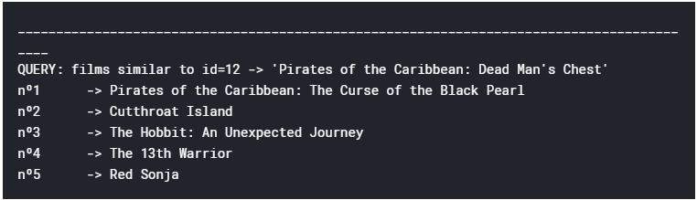

Slide 16
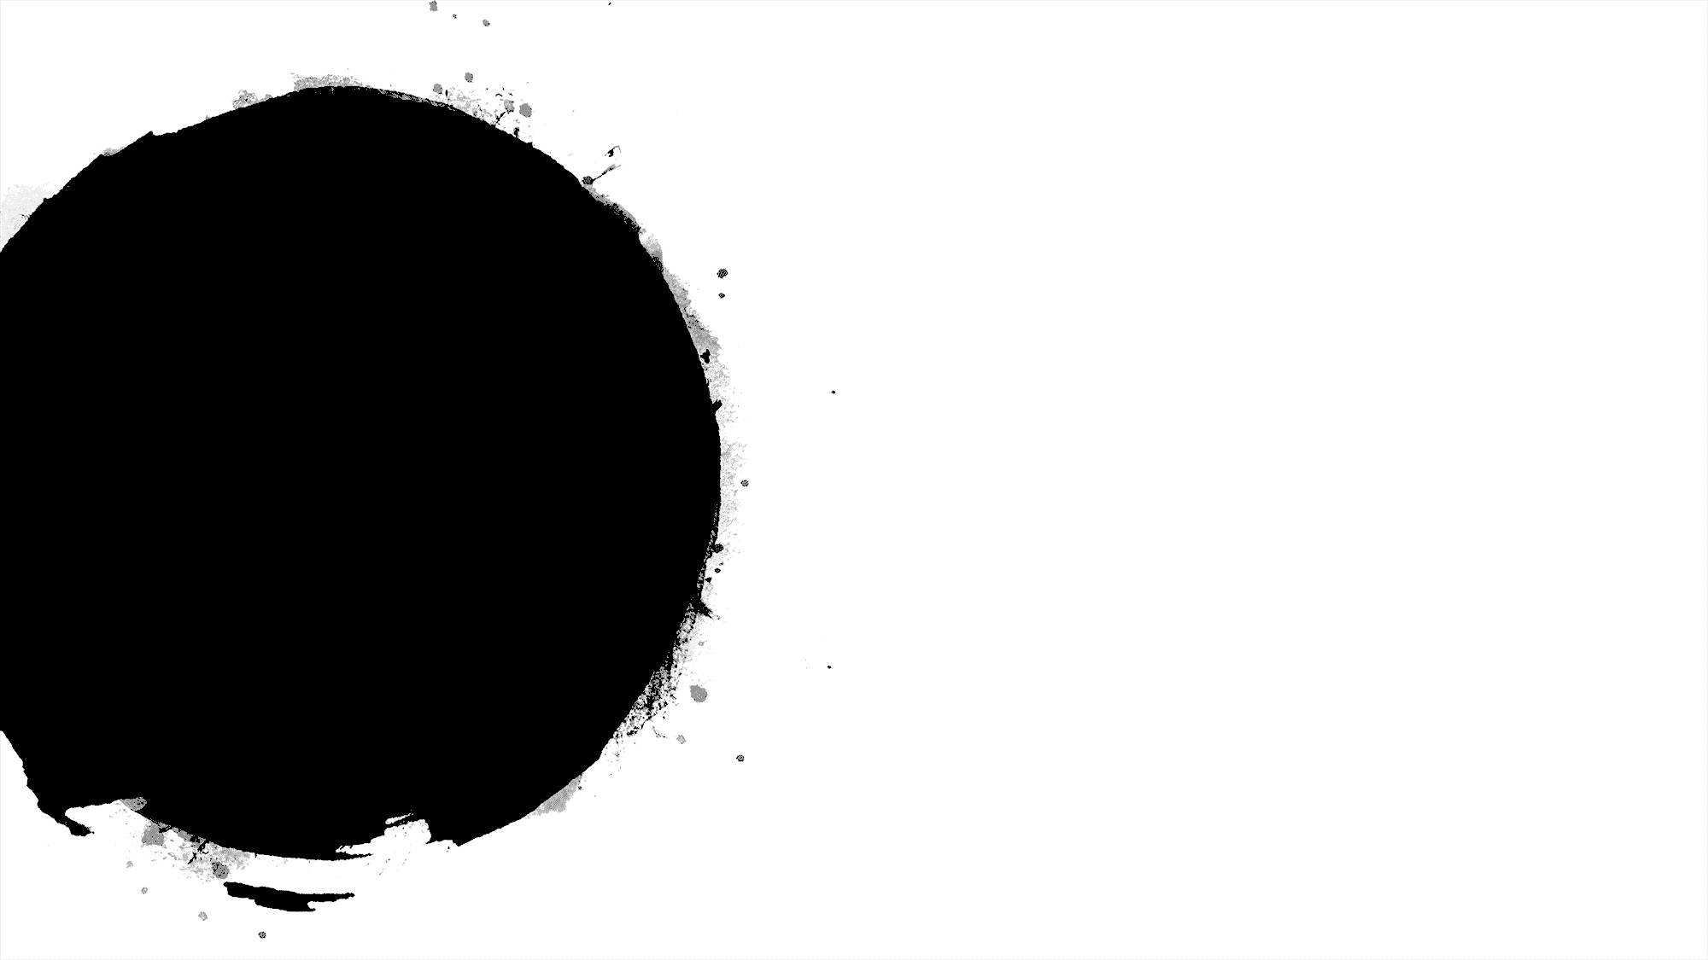
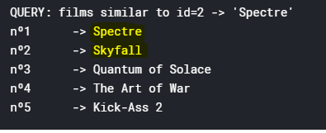
Challenges
Extend the detections of sequels to films that don't share similar titles.- working.
Replacement of the keywords with frequent synonyms. - working
Remakes cannot be distinguished.
Language of the film.
Illegal Input – movies not in the database.
Solution : Building a front end with filters and a search box with suggestion.

Slide 17
Advantages and Disadvantages
We can provide explanations of recommended items by listing content-features that caused an item to be recommended.
Able to recommend to users with unique tastes.
Sparsity- adding a new attribute.
New items not rated before.
Absence of novelty.
Cannot filter items based on quality, style or viewpoint.
Notes:
Able to recommend to users with unique tastes.
Able to recommend new and unpopular items
Can provide explanations of recommended items by listing content-features that caused an item to be recommended.

Slide 18
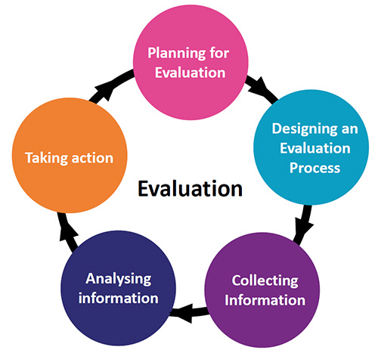
User based Evaluation
Users asked to use the system and get recommendations.
Encouraged several rounds of feedback.
Rated all movies in final list of recommendations.
Selected movies - Returned reviews after watching selections.
Completed questionnaire about the system.

Slide 19
【Code Demo】
https://github.com/leeyilin/film-rs/blob/master/demo.ipynb

Slide 20

Step Forward
1
06
05
User Profiling
Social media, Data Analysis,
Feedbacks etc..
04
Multiple algorithms
Cinematch, Dinosaur Planet, Gravity and Pragmatic Chaos
03
Hybrid Approach
Content based similarity and weights from collaborative method
02
Other techniques
Regression and clustering techniques.
01
Try to reduce Popularity bias
Support users with unique taste.
Consider more features
More meaningful recommendation

Slide 21
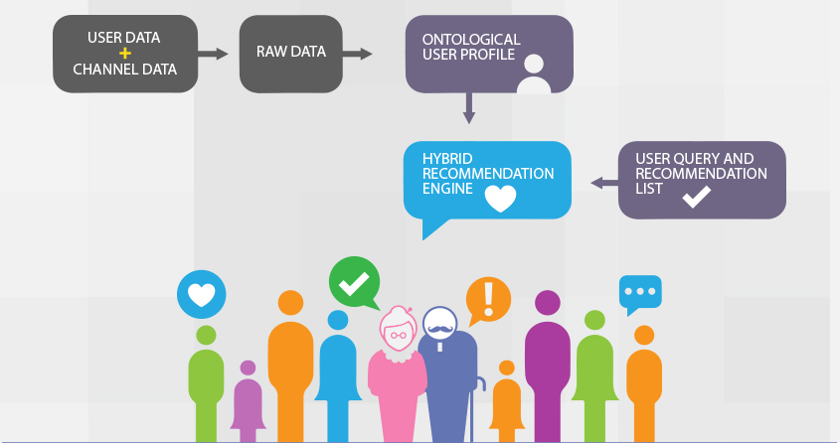

Slide 22


Slide 23
Thank you
Group 7
Supriya Parthiban 20567171
Huang Yi 20538986
LI Yilin 2056 3096
Yan ziqi 20543632
Lu Yao 20552578
Notes:
模板来自于 http://www.ypppt.com

